Slide 1


Computation with
Bayes Theorem
6040 Bayesian Machine Learning
Prof. Bill Basener

Slide 2

Topics:
Reading: Basener & Brown, through Section 1.4. (https://github.com/wbasener/BayesianML)
Additional Material (Oxford Bayesian Statistics Videos - https://www.youtube.com/watch?v=U1HbB0ATZ_A&list=PLFDbGp5YzjqXQ4oE4w9GVWdiokWB9gEpm , Open Data Science, Wikipedia)
Bayes Theorem - example
Notation
Python Code
Chapter 1

Slide 3
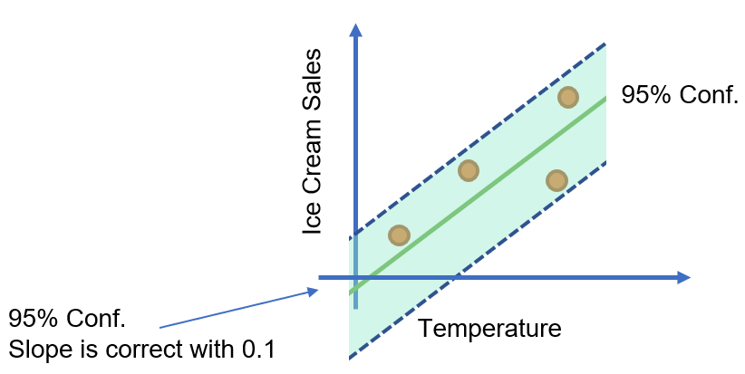
Bayesian Machine Learning:
Chapter 1

Slide 4
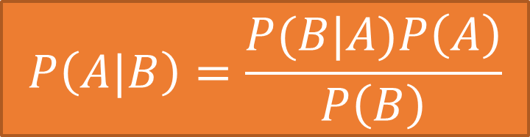
Bayes Theorem:
Alternative Notation:
$$P\left(A|B\right)=\frac{P(B|A)P\left(A\right)}{P\left(B\right)}$$
*From Video 1.13 on “Expectation and Conditioning”

Slide 5


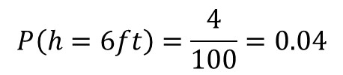
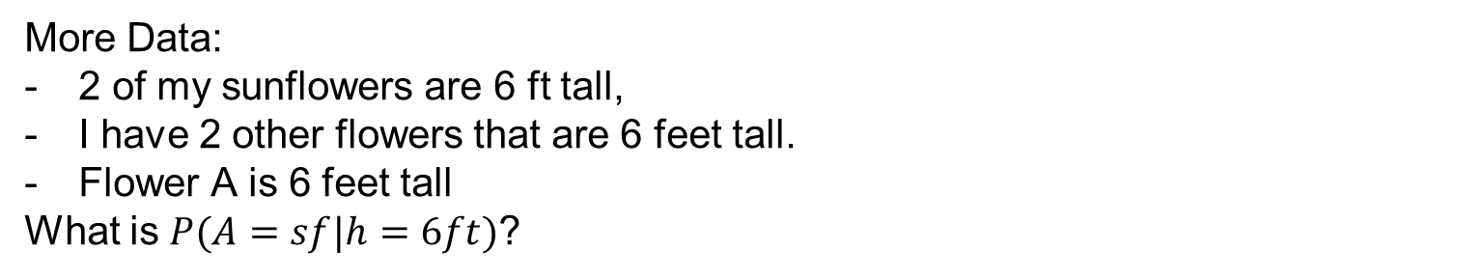

Bayes Theorem:
$$P\left(A|B\right)=\frac{P(B|A)P\left(A\right)}{P\left(B\right)}$$
Use, updating belief:
Data: I have 100 flowers in my yard, 3 of which are sunflowers.
What is $P(A=sf$)? (A is a random variable for the type of flower, sf=sunflower.)
$$P(A=sf)=\frac{3}{100}=0.03$$
More Data:
2 of my sunflowers are 6 ft tall,
I have 2 other flowers that are 6 feet tall.
Flower A is 6 feet tall
What is $P(A=sf|h=6ft)$?
$$P\left(h=6ft|A=sf\right)=2/3$$
$$P\left(h=6ft\right)=\frac{4}{100}=0.04$$
Chapter 1

Slide 6

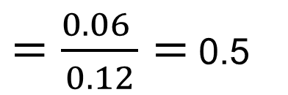
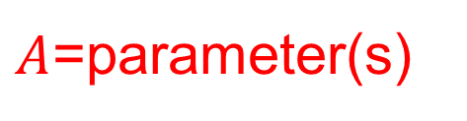

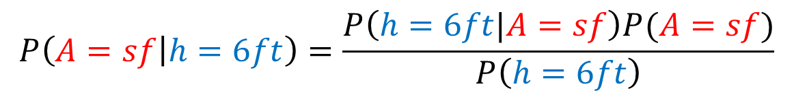
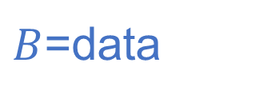
$B$=data
$A$=parameter(s)
Bayes Theorem:
$$P\left(A|B\right)=\frac{P(B|A)P\left(A\right)}{P\left(B\right)}$$
Use, updating belief:
Prior Probability
Data: I have 100 flowers in my yard, 3 of which are sunflowers.
What is $P(A=sf$)? (A is a random variable for the type of flower, sf=sunflower.)
$$P(A=sf)=\frac{3}{100}=0.03$$
More Data:
2 of my sunflowers are 6 ft tall,
I have 2 other flowers that are 6 feet tall.
Flower A is 6 feet tall
What is $P(A=sf|h=6ft)$?
$$P\left(h=6ft|A=sf\right)=2/3$$
$$P\left(h=6ft\right)=\frac{4}{100}=0.04$$
Posterior Probability
$$P\left(A=sf | h=6ft\right)=\frac{P\left(h=6ft|A=sf\right)P(A=sf)}{P\left(h=6ft\right)}$$
$$=\frac{2/3×0.03}{0.04}$$
$=\frac{0.06 }{0.12}=$ 0.5
Chapter 1

Slide 7
$B$=data
$A$=parameter(s)
Bayes Theorem:
$$P\left(A|B\right)=\frac{P(B|A)P\left(A\right)}{P\left(B\right)}$$
Use, updating belief:
Prior Probability
Data: I have 100 flowers in my yard, 3 of which are sunflowers.
What is $P(A=sf$)? (A is a random variable for the type of flower, sf=sunflower.)
$$P(A=sf)=\frac{3}{100}=0.03$$
Likelihood
More Data:
2 of my sunflowers are 6 ft tall,
I have 2 other flowers that are 6 feet tall.
Flower A is 6 feet tall
What is $P(A=sf|h=6ft)$?
$$P\left(h=6ft|A=sf\right)=2/3$$
$$P\left(h=6ft\right)=\frac{4}{100}=0.04$$
Posterior Probability
$$P\left(A=sf | h=6ft\right)=\frac{P\left(h=6ft|A=sf\right)P(A=sf)}{P\left(h=6ft\right)}$$
$$=\frac{2/3×0.03}{0.04}$$
$=\frac{0.06 }{0.12}=$ 0.5
Chapter 1

Slide 8

“Everybody has a plan until you get punched in the face”
Bayesian Philosophy
Prior
Data

Slide 9

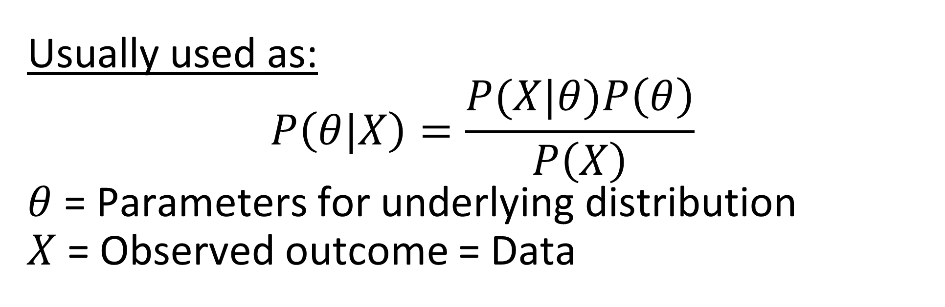
Bayes Theorem:
$$P\left(A|B\right)=\frac{P(B|A)P\left(A\right)}{P\left(B\right)}$$
Usually used as:
$$P\left(θ|X\right)=\frac{P(X|θ)P\left(θ\right)}{P\left(X\right)}$$
$θ$ = Parameters for underlying distribution
$X$ = Observed outcome = Data
Chapter 1

Slide 10
Notation/Definitions:
Y
 | 1 | 2 | 3 | 4 | 5
A | 0.1 | 0.2 | 0.05 | 0.05 | 0.1
B | 0.15 | 0.05 | 0 | 0.1 | 0.2
X
- This probability distribution has 2 variables that take on different values (called “random variables”).
- A probability distribution with multiple random variable is called a joint distribution.
- We sometimes write the joint distribution as $P(X,Y)$ to emphasize the role of the 2 variables.

Slide 11


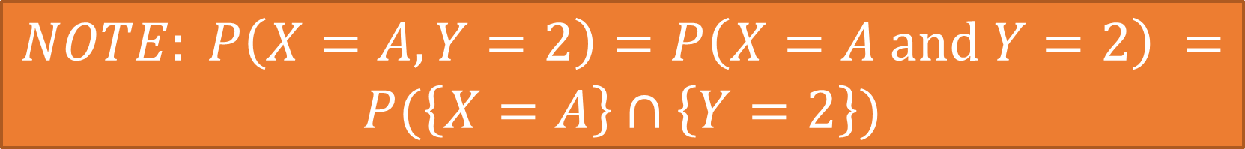
Notation/Definitions:
$$\left\{Y=2\right\}$$
$$\left\{X=A\right\}$$
Y
 | 1 | 2 | 3 | 4 | 5
A | 0.1 | 0.2 | 0.05 | 0.05 | 0.1
B | 0.15 | 0.05 | 0 | 0.1 | 0.2
X
$P\left(X=A,Y=2\right)=$
$NOTE: P\left(X=A,Y=2\right)=P\left(X=A \text{and} Y=2\right) =P(\left\{X=A\right\}∩\left\{Y=2\right\})$

Slide 12
Notation/Definitions:
$$\left\{Y=2\right\}$$
$$\left\{X=A\right\}$$
Y
 | 1 | 2 | 3 | 4 | 5
A | 0.1 | 0.2 | 0.05 | 0.05 | 0.1
B | 0.15 | 0.05 | 0 | 0.1 | 0.2
X
$P\left(X=A,Y=2\right)=0.2$
$NOTE: P\left(X=A,Y=2\right)=P\left(X=A \text{and} Y=2\right) =P(\left\{X=A\right\}∩\left\{Y=2\right\})$

Slide 13
Notation/Definitions:
Y
 | 1 | 2 | 3 | 4 | 5
A | 0.1 | 0.2 | 0.05 | 0.05 | 0.1
B | 0.15 | 0.05 | 0 | 0.1 | 0.2
X
$$P\left(Y=2\right)=$$

Slide 14

Notation/Definitions:
Y
 | 1 | 2 | 3 | 4 | 5
A | 0.1 | 0.2 | 0.05 | 0.05 | 0.1
B | 0.15 | 0.05 | 0 | 0.1 | 0.2
X
$P\left(Y=2\right)=0.2+0.05=0.25$
The probability distribution $P(X)$ is called the marginal distribution, defined as:
$P\left(X=x\right)=\sum_{y}{P(X=x,Y=y)}$.

Slide 15
Notation/Definitions:
Y
P(X,Y)
 | 1 | 2 | 3 | 4 | 5
A | 0.1 | 0.2 | 0.05 | 0.05 | 0.1
B | 0.15 | 0.05 | 0 | 0.1 | 0.2
P(X)
0.5
0.5
X
P(Y) | 0.2 | 0.25 | 0.05 | 0.15 | 0.3
The probability distribution $P(X)$ is called the marginal distribution, defined as:
$P\left(X=x\right)=\sum_{y}{P(X=x,Y=y)}$.
(“sum rule”)

Slide 16

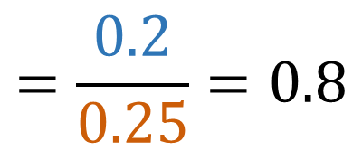
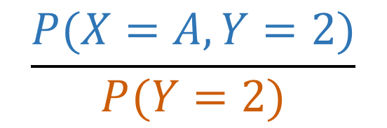
Notation/Definitions:
Y
 | 1 | 2 | 3 | 4 | 5
A | 0.1 | 0.2 | 0.05 | 0.05 | 0.1
B | 0.15 | 0.05 | 0 | 0.1 | 0.2
X
$$\frac{P(X=A,Y=2)}{P(Y=2)}$$
$$=\frac{0.2}{0.25}=0.8$$
$P\left(X=A|Y=2\right)=$
$$P(X=x|Y=y\text{)} =\frac{P(X=x,Y=y\text{)}}{P\left(Y=y\right)}$$

Slide 17
Bayes Theorem:
From Previous Slide:
$$P\left(A|B\right)=\frac{P(B|A)P\left(A\right)}{P\left(B\right)}$$
*From Video 1.13 on “Expectation and Conditioning”

Slide 18

Likelihoods
DEFINITION: For a given probability distribution P and data X, the likelihood function is a function L defined by
$$L\left(θ|X\right)=f(X|θ)$$
Where $f(X|θ)$ is the PDF (continuous case) or PMF (discrete case) for the probability distribution P.
NOTATION: We often write $L\left(θ|X\right)=P\left(X | θ\right)$, using the notation for the discrete case (where the probability mass function f is equal to the probability distribution for individual points in S).
You should see that this is mathematically TRIVIAL. All we are doing is treating the parameters as viariables in the likelihood and the data is assumed fixed, whereas in the PMF/PDF the data is treated as the variable and the parameters are assumed to be fixed.

Slide 19

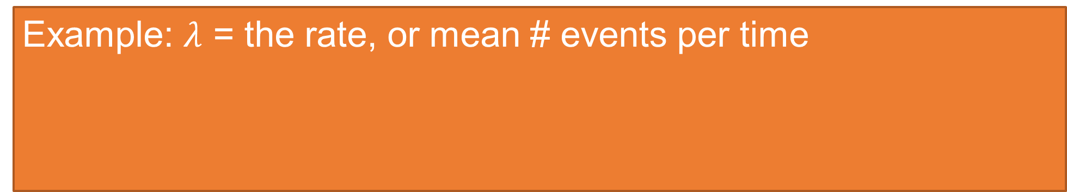
Likelihoods
DEFINITION: For a given probability distribution P and data X, the likelihood function is a function L defined by
$$L\left(θ|X\right)=f(X|θ)$$
Where $f(X|θ)$ is the PDF (continuous case) or PMF (discrete case) for the probability distribution P.
NOTATION: We often write $L\left(θ|X\right)=P\left(X | θ\right)$, using the notation for the discrete case (where the probability mass function f is equal to the probability distribution for individual points in S).
Example: $λ$ = the rate, or mean # events per time
$$f\left(k|λ\right)=λ^{k}\frac{e^{−λ}}{k!}$$
$f\left(k|λ\right)$ = the probability of observing $k$ events if the rate is $λ$.
$L\left(λ|k\right)$ = the likelihood for $λ$ if $k$ events were observed.

Slide 20


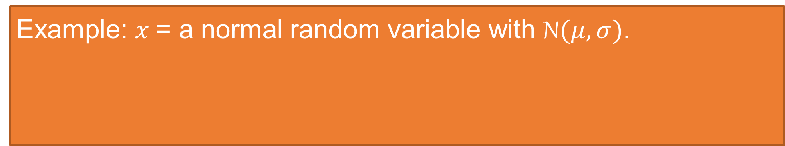
Likelihoods
DEFINITION: For a given probability distribution P and data X, the likelihood function is a function L defined by
$$L\left(θ|X\right)=f(X|θ)$$
Where $f(X|θ)$ is the PDF (continuous case) or PMF (discrete case) for the probability distribution P.
NOTATION: We often write $L\left(θ|X\right)=P\left(X | θ\right)$, using the notation for the discrete case (where the probability mass function f is equal to the probability distribution for individual points in S).
Example: $x$= a normal random variable with N$(μ,σ)$.
$\int_{a}^{b}{\frac{1}{σ\sqrt{2π}}e^{−\frac{1}{2}{\left(\frac{x−μ}{σ}\right)}^{2}}dx}$= the probability that $x$ is in $[a,b]$.
$$f(x|μ,σ)=\frac{1}{σ\sqrt{2π}}e^{−\frac{1}{2}{\left(\frac{x−μ}{σ}\right)}^{2}}$$
$L\left(μ,σ|x\right)$ = $f(x|μ,σ)=$the likelihood for $μ,σ$ given $x$.

Slide 21
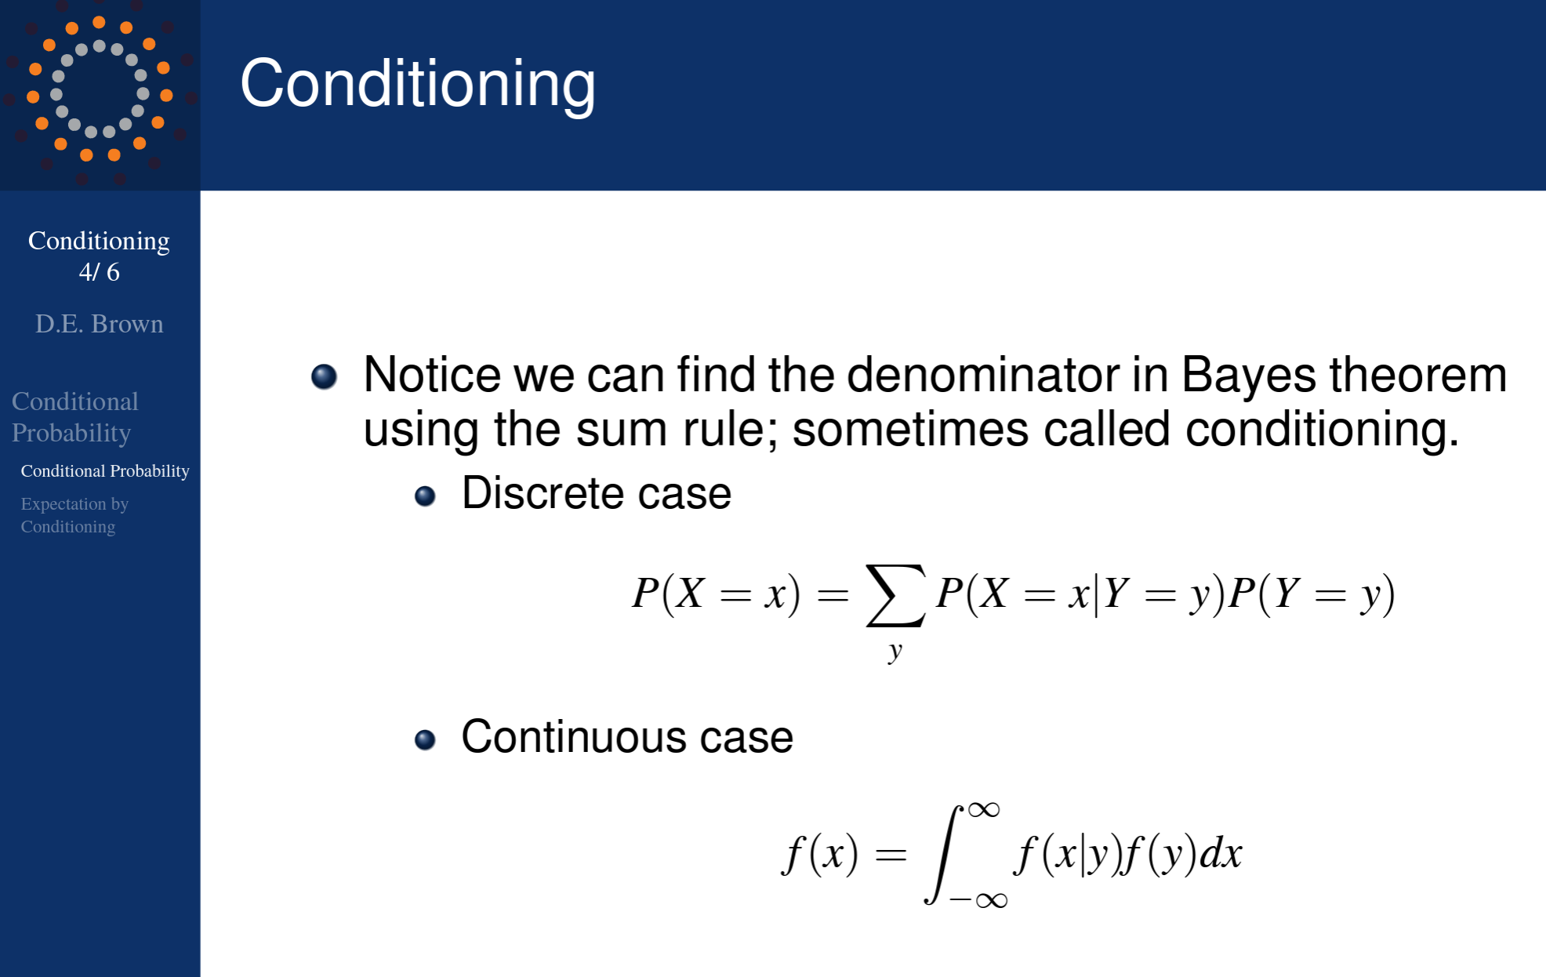
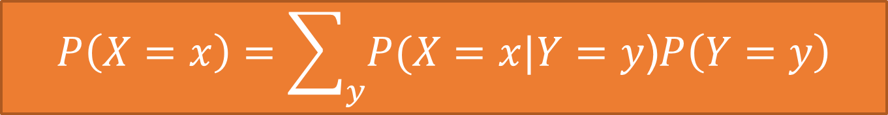

How do we compute the denominator (“evidence”)?
Dfn of marginal distribution:
$P\left(X=x\right)=\sum_{y}{P(X=x,Y=y\text{)}}$.
Dfn of conditional probability:
$$P(X=x,Y=y\text{)}=P(X=x|Y=y\text{)}P\left(Y=y\right)$$
“conditioning:
$$P\left(X=x\right)=\sum_{y}{P(X=x|Y=y\text{)}P\left(Y=y\right)}$$

Slide 22
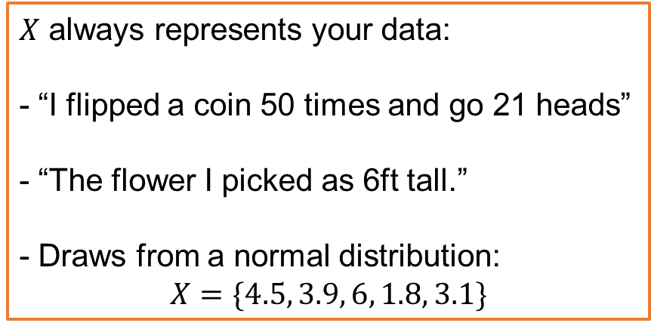
Review:
In Bayesian Statistics, the data is fixed.
$X$ always represents your data:
- “I flipped a coin 50 times and go 21 heads”
- “The flower I picked as 6ft tall.”
- Draws from a normal distribution:
$$X=\{4.5, 3.9, 6, 1.8, 3.1\}$$

Slide 23

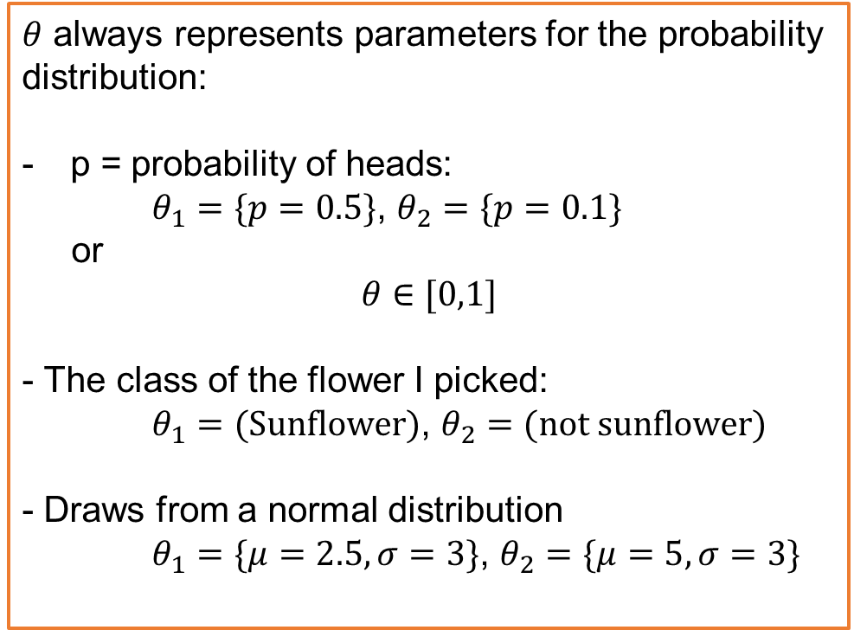
Review:
The goal is to determine the probabilities for all the possible values of $θ$, which is called the Posterior probability distribution.
$θ$ always represents parameters for the probability distribution:
p = probability of heads:
$θ_{1}=\{p=0.5\}$, $θ_{2}=\{p=0.1\}$
or
$$θ∈[0,1]$$
- The class of the flower I picked:
$θ_{1}=(\text{Sunflower})$, $θ_{2}=(\text{not} \text{sunflower})$
- Draws from a normal distribution
$θ_{1}=\{μ=2.5,σ=3\}$, $θ_{2}=\{μ=5,σ=3\}$

Slide 24
Probability Distributions, Likelihoods, and Bayes Theorem (Kaggle Notebook)
https://www.kaggle.com/billbasener/probabilities-likelihoods-and-bayes-theorem

